Slide 1
CMPE 220
Class 24 – Managing System Software
Notes:
Let’s talk about history.
California State Railroad Museum – 1976 - docents worked on original steam engines.

Slide 2
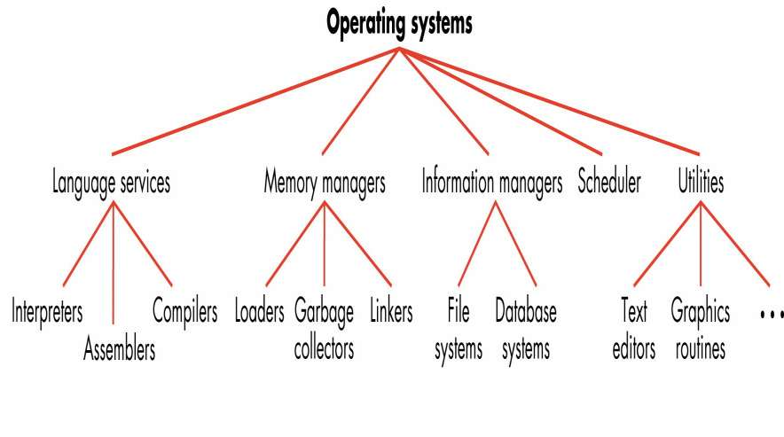
Core System Software

Slide 3
Utilities
Utility software is system software designed to help analyze, configure, optimize or maintain a computer
A single piece of utility software is usually called a utility or tool
Utility software usually focuses on how the computer infrastructure (including the computer hardware, operating system, application software and data storage) operates
Not essential

Slide 4
Utilities versus Applications
Utilities typically depend on knowledge of, or access to, the operating system, instruction set, or hardware
Cannot be moved to another system simply by recompiling

Slide 5
System Utilities – File System
Backup/restore utilities can make a copy of all information stored on a disk, and restore either the entire disk (e.g. in an event of disk failure) or selected files (e.g. in an event of accidental deletion).
Data compression utilities output a shorter stream or a smaller file when provided with a stream or file.
Disk checkers can scan and repair operating hard drive (fsck).
Disk cleaners can find files that are unnecessary to computer operation, or take up considerable amounts of space. Disk cleaner helps the user to decide what to delete when their hard disk is full.
Disk defragmentation utilities reorganize file segments of disk to optimize future accesses.
Disk compression utilities can transparently compress/uncompress the contents of a disk, increasing the capacity of the disk.

Slide 6
System Utilities – Files
File catalog utilities provide users with an index to the contents of a file system
File indexing and search utilities allow users to search the contents of a file system
Data compression utilities (tar, zip, gzip, rar) output a shorter stream or a smaller file when provided with a stream or file
Cryptographic (data encryption) utilities encrypt and de-encrypt a stream or file
File display / edit utilities allow users to directly access the contents of a file in low-level formats (e.g. hexadecimal or octal byte values)

Slide 7
System Utilities – Remote Files
FTP fetches and sends files using the File Transfer Protocol
Curl – Client URL – transfers data to and from a server
Wget downloads files and interacts with Representational State Transfer (REST) APIs
Installation utilities download and install software
Auto-updaters keep software current
Package managers automate the process of installing, upgrading, configuring, and removing programs for a computer in a consistent manner

Slide 8
System Utilities – Remote Files
Migration utilities move user accounts, configuration information, files and applications between systems
Synchronization utilities synchronize files across systems

Slide 9
System Utilities – Version Control
Version control, revision control, source code control
Manage versions and changes for a collection of files
Local or remote access
Popular version control systems
Git / github
Apache subversion
Concurrent Versions System (CVS)
AWS CodeCommit
IBM Rational Clearcase
Azure DevOps Server
SourceForge
and dozens more

Slide 10
System Utilities – Management
Firewalls and anti-virus utilities block, scan for, and remove computer viruses.
Process/task managers display, reprioritize, and delete processes.
System monitors display system statistics, e.g.:
number and status of Process Control Blocks (PCBs)
number of I/O Control Blocks IOCBs
Performance Monitoring Counters (PMCs)
Instructions Per Cycle (IPC)
Tunable system parameters
System profilers provide detailed information on system hardware and installed software

Slide 11
System Utilities – Network
Ping checks whether an IP address can be reached
Traceroute (tracert) provides details on all the “hops” a packet goes through to get to the destination, including switches and routers, along with the IP address, DNS information, and latency of each
Netstat displays the network connections for Transmission Control Protocol (TC) and User Datagram Protocol (UDP)
Nslookup is used to query the domain name system (DNS) for domain name or IP address mapping, or to obtain other kinds of DNS records
IPconfig used for displaying information on TCP/IP configuration and information pertaining to the DNS and Dynamic Host Configuration Protocol (DHCP).

Slide 12
System Utilities – VPNs
Virtual Private Network (VPN) - protects internet connections and privacy online
VPNs:
create an encrypted tunnel for data
protect user’s online identity by hiding their IP address
Mask the user’s location

Slide 13
System Utilities – Maintenance
Diagnostic Programs – runs hardware tests
Active diagnostics – diagnose hardware by monitoring in real time
Self-Monitoring Analysis and Reporting Technology (SMART) tracks statistics such as disk retries to predict disk failures
Disk sector sparing automatically drops bad disk sectors
Memory sparing automatically drops bad memory blocks
Log analyzers display and analyze system logs
cron utilities – schedule tasks for execution

Slide 14
Linux Command Line
Command line shell – interaction, scripting
Bourne shell (sh), C shell (csh), Bourne Again Shell (bash), tsh, tcsh, ksh, zsh, fish, etc
Make – automates the program build process
ls – lists files
cat – concatenates (copies) files
find – searches the file system
grep – searches within files for regular expressions
ps – lists processes and attributes
and > 100 more

Slide 15
MS Windows - Registry
What is the Registry?
A hierarchical database that stores low-level settings for the Windows operating system, and for applications that opt to use the registry
The kernel, device drivers, services, Security Accounts Manager, and user interfaces can all use the registry
Registry cleaner / editor utilities remove redundant or unused registry entries, and may allow editing of registry parameters

Slide 16
Miscellaneous User Utilities
Screen savers
Screen capture / snapshot
Password managers
Calendars
GUI customization
Font managers

